Slide 1
Enhancement Due to Photonic Coupling in Nanocavity Structures
Bumbia, Amal;
Abudayyeh, Hamza;
Liu, Zhida;
Li, Xiaoqin
Department of Physics UT Austin
Notes:
gwiddyon

Slide 2
Outline and Key Concepts
Quantum emitters
(plasmonic) cavities
Transition Metal Dichalcogenide
nanocubes
Our Sample
Dark-field spectroscopy
Photoluminescence

Slide 3
How do quantum emitters work?
Optical properties!
Spontaneous photon emission!
2-level Quantum emitter
Electromagnetic environment
How can we alter this environment to favorably influence the decay rate of the system?
multiple 2-level systems with differing polarization or wavelength
Notes:
Quantum emitters possess optical properties that are a result of an interplay between the energy levels of the emitter and its electromagnetic environment. Given a 2-level system, you can modify its decay rate by altering the environment.
Quenching occurs when the emitter is too close to the metal so no photons within < 4 nm from the metal surface are emitted. Thus, there is no optical coupling. This is a loss mechanism.

Slide 4
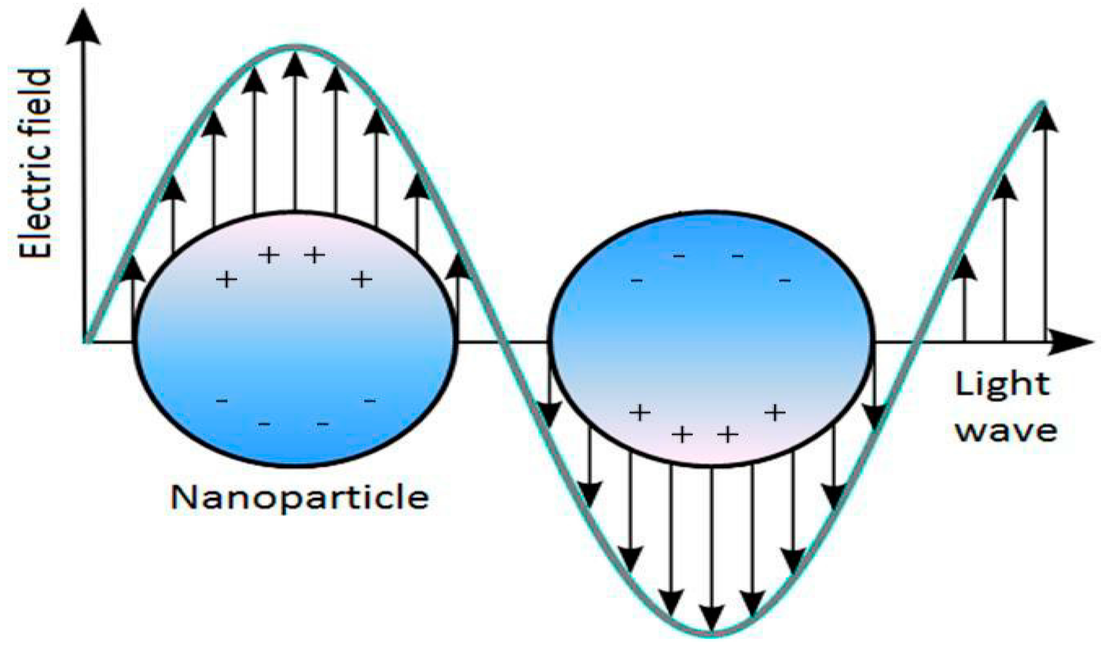
Why can a nanoscale quantum emitter can have emitting behavior?
e-
exciton
plasmon
Notes:
interaction between the excitons of the emitter and the plasmons of the nanoparticles

Slide 5
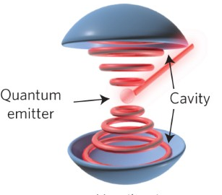
What is the interplay between quantum emitters and cavities?
enhanced photon emissions into free space
coupled resonantly
exchange photons
contains plasmonic resonances
emits into the plasmonic cavity
focuses the emission fields into a mode volume
Notes:
A plasmon refers to a partially optical and partially electronic excitation. Plasmonic cavity has different modes; looks different than this

Slide 6
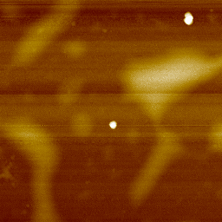
Nanocube
AFM - nanocubes exist!
shorten the lifetime of exciton emission via plasmonic nanostructures (nanocubes)
Nanocubes have plasmonic resonances

Slide 7
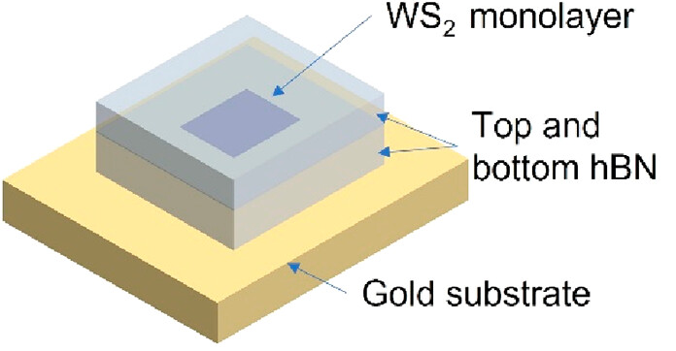
TMD - Transition Metal Dichalcogenide
Exciton resonances!

Slide 8
What are the effects of weak coupling between plasmonic nanocavities and excitons?

Slide 9
How does plasmon-exciton coupling effect emission enhancement?

Slide 10
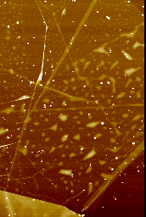
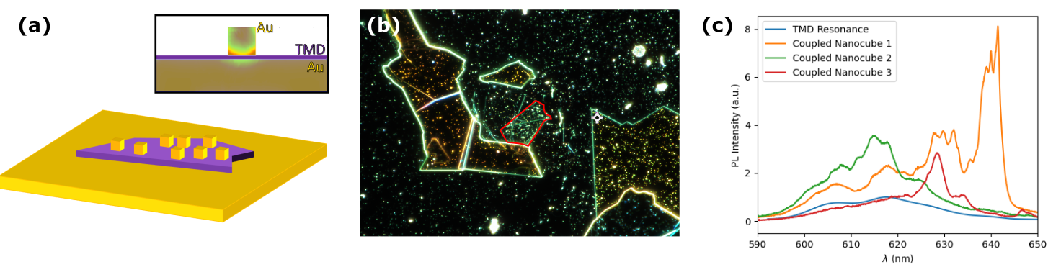
The Sample
Material: Monolayer TMD
Film-Cube Separation: 8-9 nm
cavity
nanocubes
(70-100 nm)
TMD
gold foil
Notes:
Simulation of single nanoresonance of one cube and colors are intensity of the field, increase of intensity in the corners of cube, lightning rod effect — one reason why nanocubes work how they do
A reason why nanocubes enable photonic enhancement is because the electromagnetic field is more intense at the corners of the cube - the lightning-rod effect. Nanocube size and film-cube separation impact where plasmonic resonances occur.
The excitons of the emitter and plasmons of the nanocubes couple in a plasmonic cavity which focuses the emission fields into a mode volume. The mode volume impacts the probability of the field interacting with the emitter. A higher probability in this regard increases the probability of spontaneous emission and decreases the lifetime. The photons emit from the cavity and into free space, enhanced due to the weak coupling mechanism.

Slide 11
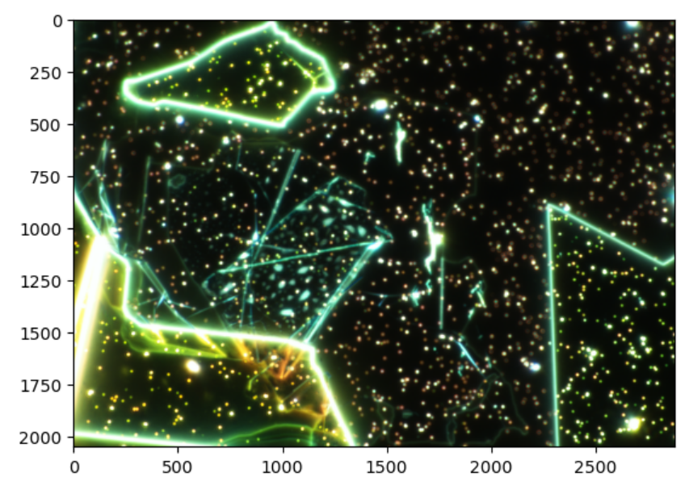
Dark-field Spectroscopy
white light scattering by nanocavities
measure plasmonic resonances
Notes:
Upon imaging the sample using dark field spectroscopy, we are able to focus on the white light
scattering by the nanocavities and thus measure plasmonic resonances.

Slide 12
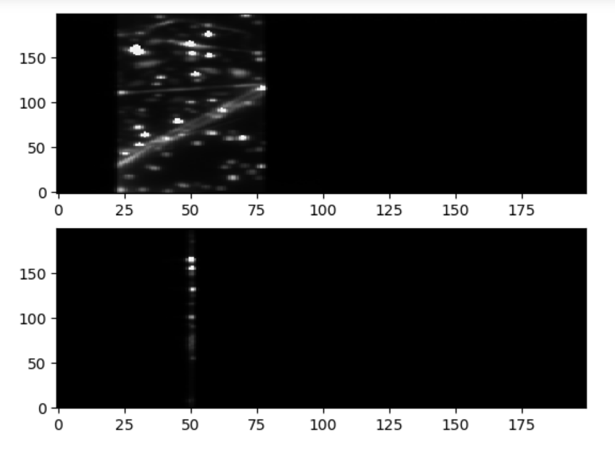
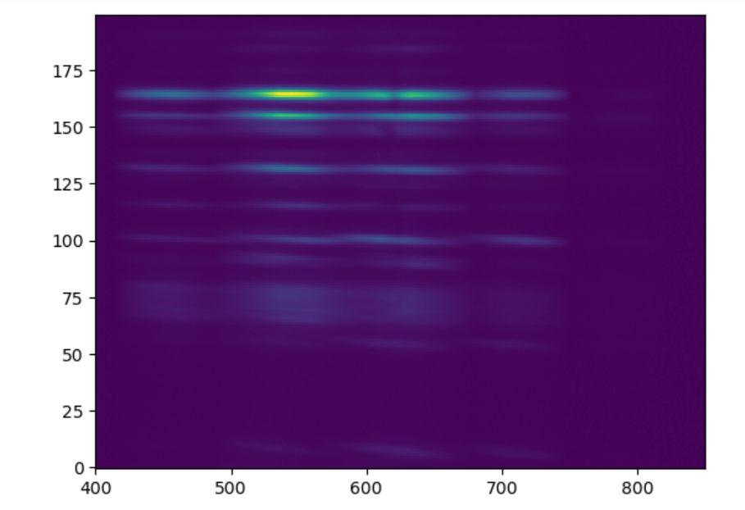
Emission spectrum of a nanocube
Focusing on a single nanocube point

Slide 13
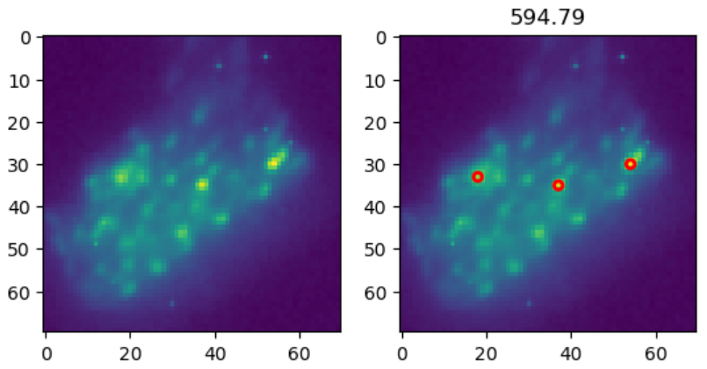
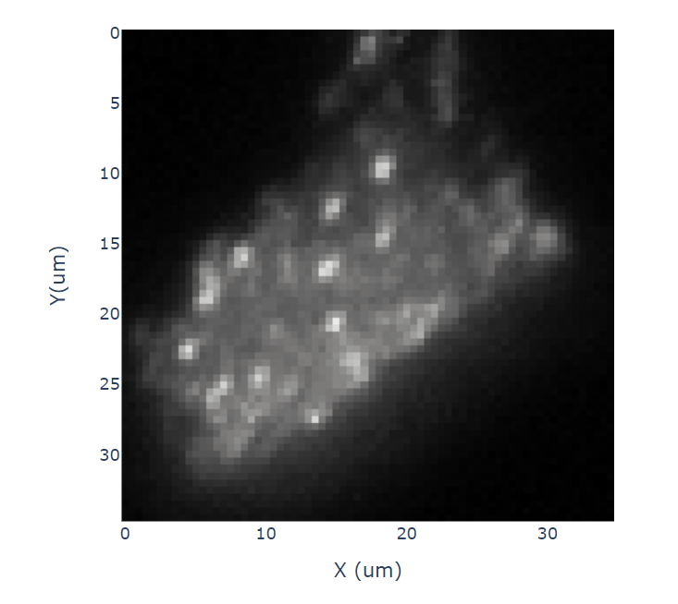
Hyperspectral Spatial Image
well localized points with nanocubes
intensity coming out of these points is enhanced

Slide 14
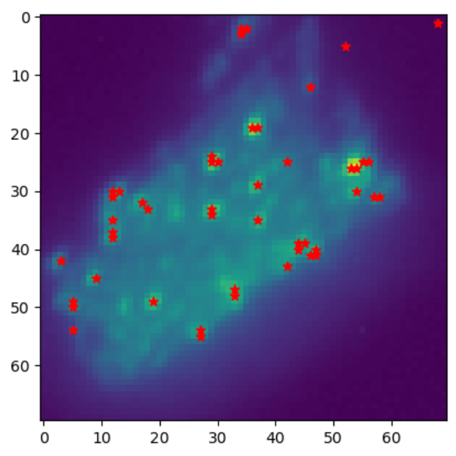
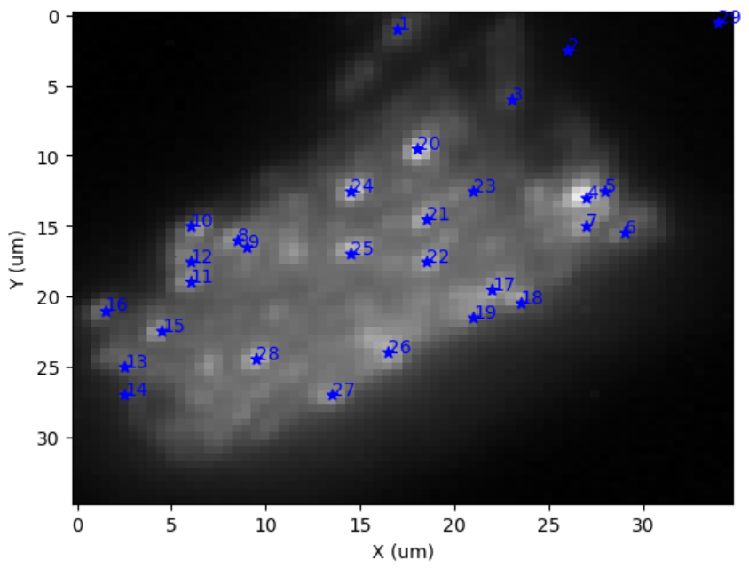
Notes:
Points of interest

Slide 15
Photoluminescence (PL)
excite sample at different wavelengths
measure exciton resonances
longer wavelengths enhanced
greater, non-uniform intensity enhancement along nanocubes
overlap between the wavelengths where plasmonic resonances and enhancement occur
Enhanced exciton emissions!
Notes:
Overlap between the plasmonic resonances and exciton excitation
provides evidence for the coupling as it facilitates enhancement. Longer wavelengths are enhanced, and there is greater, non-uniform intensity enhancement along the nanocubes. Differently sized cubes enhance different parts of exciton spectrum. We see that the enhanced resonances have the same polarizations and spectral resonances as the plasmonic resonances.

Slide 16
Future Applications
insight to optical properties of quantum emitters
manipulate emitters by altering their EM environment
enhance previously weak emissions
nanophotonic devices
manipulating light-matter interaction at the nanoscale

Slide 17
Acknowledgements
I would like to thank Dr. Hamzah Abudayyeh and Dr. Xiaoqin Li for giving me the opportunity to work on this project.

Slide 18
HIDDEN SLIDES

Slide 19
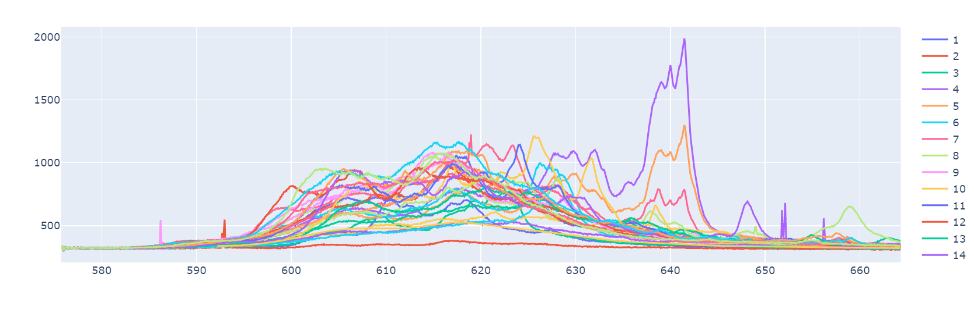

Slide 20
Coupling parameters:
emitter's decay in free space $\Gamma _0$\\
cavity's loss rate $\kappa$\\
emitter-cavity coupling coefficient $g$\\
Cavities can impact emitters in a few ways:
decay rate enhancement --- The weak coupling of a 2-level emitter to a cavity leads to the modification of the spontaneous emission rate. The emitter can have multiple radiative modes and some nonradiative processes
emission redirection --- the intrinsic radiation pattern of a quantum emitter is omnidirectional, making it hard to collect emitted photons. Cavities can redirect the emission to the desired optical mode with an efficiency $\eta _{NA}$. Different modes can have different efficiencies.
absorption enhancement --- cavities alter the absorption cross-section of the emitter which causes absorption enhancement and lowers the saturation power needed from the pump laser.
This is dependent on the overlap of the photonic cavity and the resonances of the 2-level system. Due to the interplay between the photonic cavity and the system, we are able to enhance some processes at the expense of others. For instance, if the resonances of the plasmonic cavity are vertical, they selectively enhance dipole emitters with a vertical dipole. Not only are we increasing the lifetime, but we are also altering our characterization and probability of the emission.
Notes:
What matters is coherence and its impact on the photonic field. We aim to enhance all photons in the emission.
A process will impact a lower-probability event more than one with a higher probability since quantum efficiency has a lesser chance of being improved in the latter.

Slide 21
Weak Coupling Regime
We are concerned with the weak coupling regime $g < \kappa$, $\Gamma _0$. Here, the photon is released by an excited emitter due to spontaneous emission and lost to far-field radiation modes leaving the cavity in a vacuum state. In this case, the cavity becomes the system's environment and results in a modified decay rate $\Gamma = F \Gamma _0$ where $F = \frac{3}{4\pi ^2} Q \frac{\lambda ^3}{V}$ (Purcell factor - represents the shortening of lifetimes; losses ensure that it is not directly related to the number of emitted photons), $Q \approx \frac{1}{\kappa}$ (cavity quality factor), and the cavity mode volume $\frac{V}{\lambda ^3}$. The advantage of the weak coupling regime is that for emitted photons, the probability that they will be reabsorbed by the emitter is low compared to the likelihood of the photon escaping the cavity.

Slide 22
Methods
Use AFM to confirm nanocubes
Pick nanocube points of interest
Map their plasmonic resonances using dark-field spectroscopy
Use PL to graph enhancement due to exciton emission
Does an overlap between the plasmonic resonances and exciton excitation exist?

